Slide 1

Design and analysis of algorithms
CSB 252
NATIONAL INSTITUTE OF TECHNOLOGY DELHI

Slide 2
What we will discuss
Dynamic Programming
Divide and conquer
Branch and bound

Slide 3
Dynamic Programming
Most often, subproblems are solved multiple times in an algorithm
Since solution has once been evaluated, one can consider the same solution again
Trades space complexity for a better time complexity
Since space doesn’t have much value over time, Dynamic Programming is more useful now
Happens often in real life, most commonly while memorizing the solutions to common problems (both social or academical)
The two main properties of a problem that suggests that the given problem can be solved using Dynamic programming
Overlapping Subproblems
Optimal Substructure

Slide 4
Dynamic Problem Algorithm with Edit Distance Problem
Two strings str1(length m) and str2 (length n)and below operations that can performed on str1. We have to minimum number of edits (operations) required to convert ‘str1’ into ‘str2’.
Insert
Remove
Replace
What are the subproblems in this case?
1. If last characters of two strings are same, nothing much to do. Ignore last characters and get count for remaining strings. So we recur for lengths m-1 and n-1.
2. Else (If last characters are not same), we consider all operations on ‘str1’, consider all three operations on last character of first string, recursively compute minimum cost for all three operations and take minimum of three values.
Insert: Recur for m and n-1
Remove: Recur for m-1 and n
Replace: Recur for m-1 and n-1

Slide 5
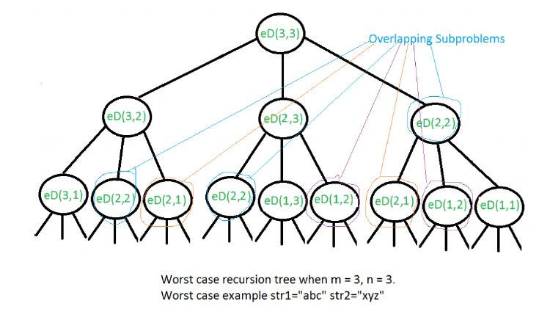
Many subproblems are solved, again and again, for example, eD(2,2) is called three times. Since same suproblems are called again, this problem has Overlapping Subprolems property.

Slide 6
Divide and Conquer
Divide: This involves dividing the problem into sub problem.
Conquer: Sub problem by calling recursively until sub problem solved.
Combine: The Sub problem solved so that we will get find problem solution.
Example: Longest Common Prefix using Divide and Conquer Algorithm
In this algorithm, a divide and conquer approach is discussed. We first divide the arrays of string into two parts. Then we do the same for left part and after that for the right part. We will do it until and unless all the strings become of length 1. Now after that, we will start conquering by returning the common prefix of the left and the right strings.

Slide 7
Branch And Bound
Considers the set of candidate solutions as a rooted tree
Explores branches of the tree that represents the subsets of the solution set
Considers the upper and lower bounds by assigning a value that distinguishes the solution from the others
Results to an exhaustive search if no bounds can be found, testing every possible solution in the subset.
Code complexity increases

Slide 8
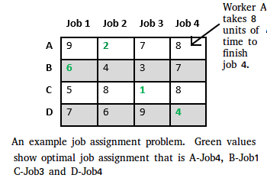
Job Assignment Problem using Branch And Bound
There are two approaches to calculate the cost function:
For each worker, we choose job with minimum cost from list of unassigned jobs (take minimum entry from each row).
For each job, we choose a worker with lowest cost for that job from list of unassigned workers (take minimum entry from each column).
Approach
Let’s take below example and try to calculate promising cost
when Job 2 is assigned to worker A.

Slide 9
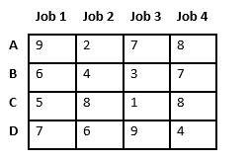
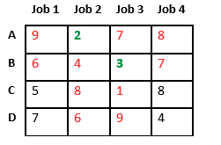
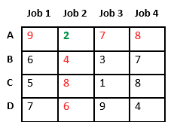
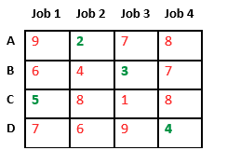
Since Job 2 is assigned to worker A (marked in green), cost becomes 2 and Job 2 and worker A becomes unavailable (marked in red).

Slide 10
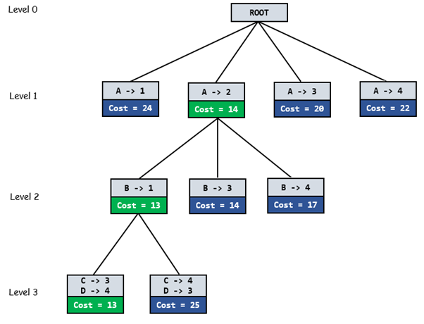
GIven diagram shows complete search space diagram showing optimal solution path in green.

Slide 11
THANKS
Abhishek Kumar Suman 18121002
Prashant Chauhan 181210035
NATIONAL INSTITUTE OF TECHNOLOGY DELHI

